Slide 1
CSE321: Operating Systems
Introduction
FBA

Slide 2
Course Outcome
To understand the fundamental concepts of computer system organization and the structure of operating systems.
To explore various aspects of process management in operating system
To know how different CPU scheduling algorithm works and their respective importance
To develop practical knowledge on the concept of threads
To inspect process synchronization mechanisms and deadlocks
To be able to analyze the management of main and virtual memory

Slide 3

Marks Distribution
Theory – 80%
Class participation – 5%
Quiz – 15%
Mid – 25%
Final – 35%
Lab – 20%

Slide 4

Operating Systems
"Actual” Introduction
FBA

Slide 5
What is an Operating System?
A program that acts as an intermediary
between a user of a computer and the computer hardware.
USER Application
( a program or application or interface)
Operating System
( a system software )
Hardware
( processor, monitor, keyboard etc. )

Slide 6
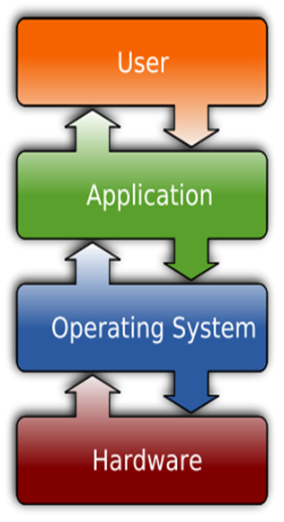
System Software Vs Application Software
System Software:
System Software refers to the operating system and all utility programs that manage computer resources at a low level.
Systems software includes compilers, loaders, linkers, and debuggers.
Application Software:
Applications software comprises programs designed for an end user, such as word processors, database systems, and spreadsheet programs.

Slide 7
Major Goals of OS
Execute user programs.
Make the computer system convenient to use.
Use the computer hardware in an efficient manner
Manages and allocate all resources
Controls the execution of user programs and operations of I/O devices

Slide 8
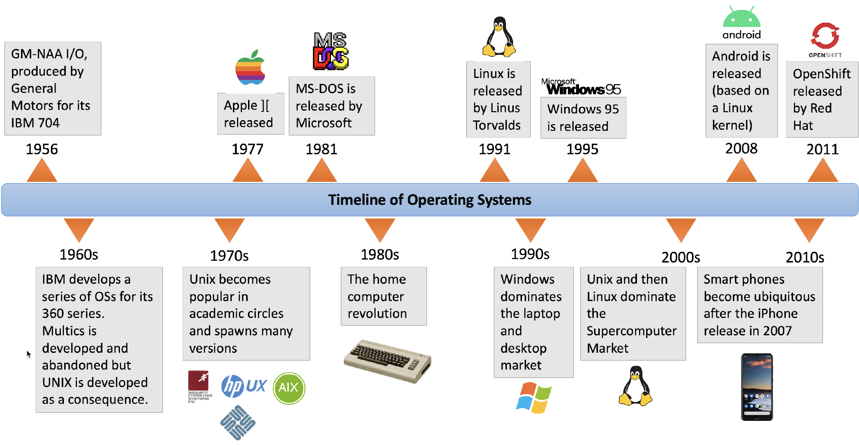
Timeline of OS

Slide 9
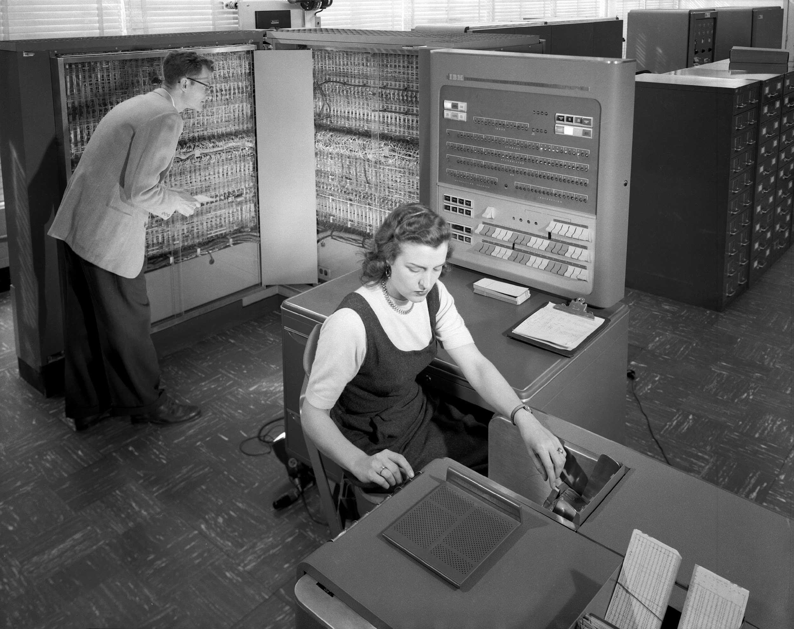
Timeline of OS
IBM 704 was the first mass-produced computer
GM-NAA (General Motors-North American Aviation) I/O is the OS used in the IBM 704
There was no UI in the OS as we know now
It was mostly based on command prompts (terminals)

Slide 10
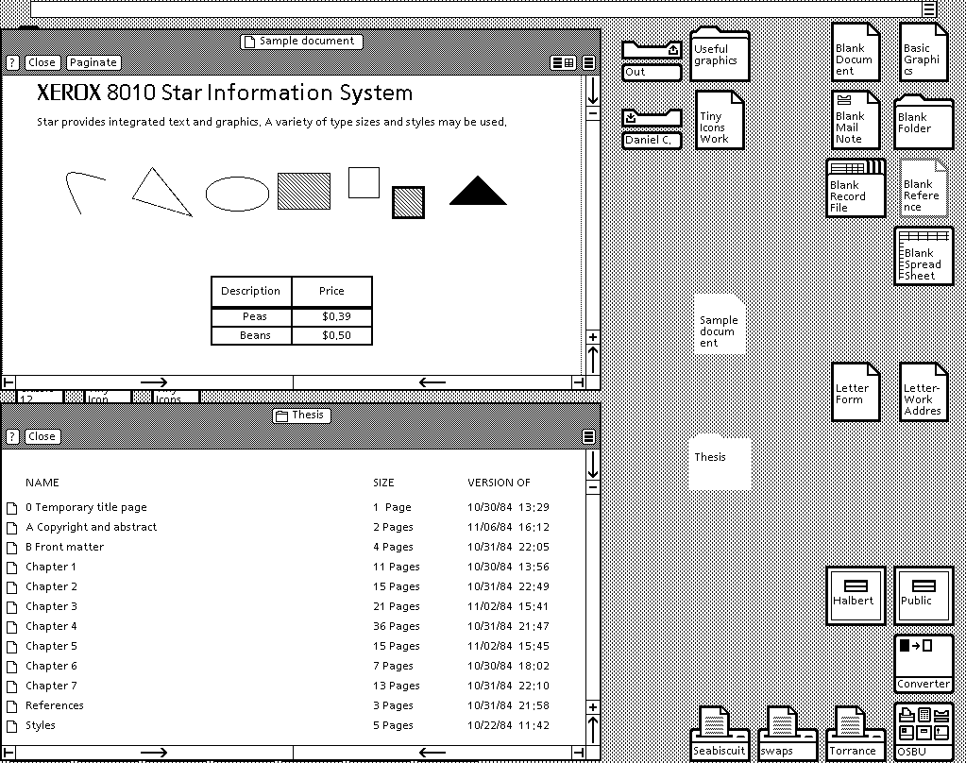
Timeline of OS
Xerox 8010 Star (released in 1981) was the first system that was referred to as a fully integrated desktop computer including applications and a GUI

Slide 11
Timeline of OS
Bill Gates got lucky to sign the so-called “Deal of the Century” with IBM to design a new OS for IBM machines
The deal allowed Microsoft to add an OS with $50 per PC and IBM did not own copyright for the OS
This allowed Microsoft to start the their OS dominance on the PC domain

Slide 12
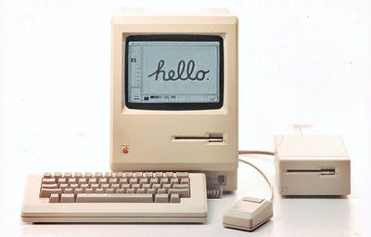
Timeline of OS
Developed by Apple Computer, Inc for their new product, the Macintosh home PC, The Macintosh 128K, was released in 1984
was widely advertised (the famous 1984 commercial is available below).
Mac OS was the first OS with a GUI built-in
It was also one of the first consumer computers with mouse!
Even though Microsoft introduced mouse in their PCs a bit earlier
The use of GUI with mouse was not Steve Job’s idea, the idea was taken during his visit in Xerox PARC (Palo Aalto Research Center)
Jobs reportedly traded US $1 million in stock options to Xerox for a detailed tour of their facilities and current projects
One of the things Xerox showed Jobs was the Alto, which sported a GUI and a three-button mouse

Slide 13
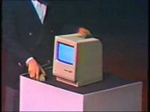
Timeline of OS

Slide 14
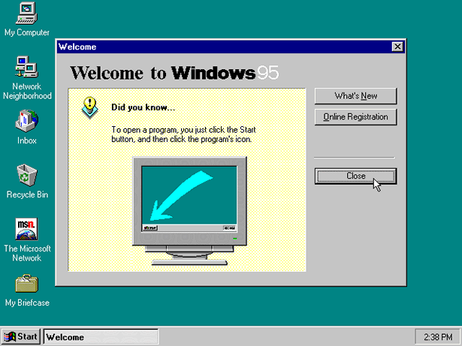
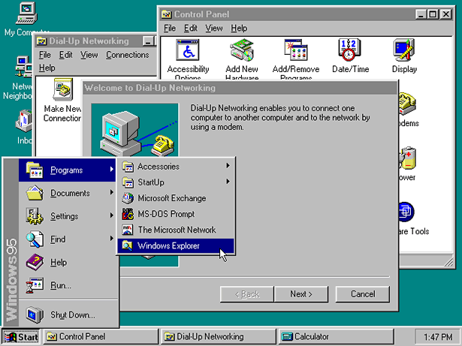
Timeline of OS

Slide 15
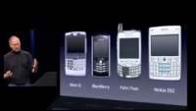
Timeline of OS
Another revolution of OS came in the mobile computing domain, when Steve Jobs introduced iPhone with iOS in 2007
The iPhone introduction video is now regarded as a classic advertise video

Slide 16
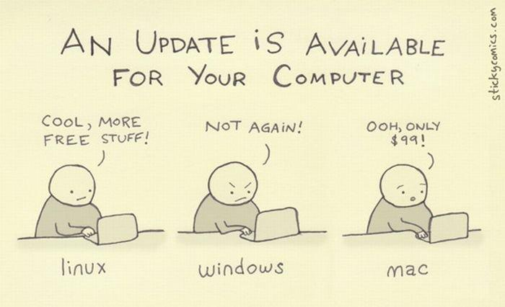

Slide 17
Operating Systems
Computer System Organization
FBA

Slide 18
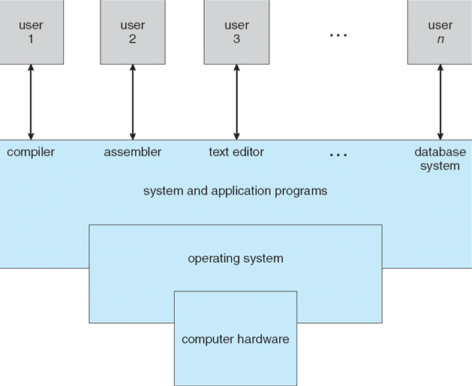
Components of a Computer System

Slide 19
Kernel
The one program running at all times.
Kernel is the central module of an operating system
Part of OS that loads first, and it remains in main memory.
As small as possible
Provide all the essential services required by other parts of the operating system and applications.
Kernel code is usually loaded into a protected area of memory to prevent it from being overwritten.

Slide 20
Bootstrap Program
An initial program executed when a computer starts running.
When a computers is powered up or rebooted, it is executed first.
Stored in the ROM or EEPROM, known as firmware
Initializes all aspects of the system, from CPU registers to device controllers to memory contents
bootstrap program must know how to load the operating system and how to start executing
Once the OS kernel is loaded and executing, it can start providing services to the system and its users

Slide 21
Storage Structure
Main memory – only large storage media that the CPU can access directly
Random access
Typically volatile
Secondary storage – extension of main memory that provides large nonvolatile storage capacity
CPU can load instructions only from main memory.
General-purpose computers run most of their programs from rewritable memory, called main memory ( also called RAM)
Computers use other forms of memory as well - Read Only Memory (ROM) and electrically erasable programmable read-only memory (EEPROM)
Only static programs, such as the bootstrap program described earlier, are stored here.

Slide 22
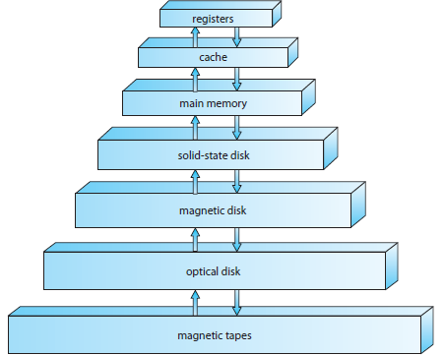
Storage Device Hierarchy

Slide 23
Operating Systems
OS Architecture
FBA

Slide 24
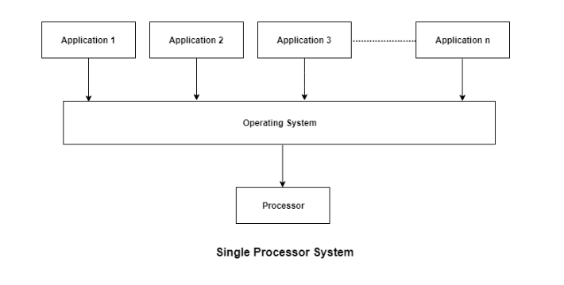
Operating System Architecture
Single-Processor Systems:
One main CPU capable of executing a general-purpose instruction set.
Almost all single processor systems have other special-purpose processors (device-specific processors), which run a limiter instruction set.

Slide 25
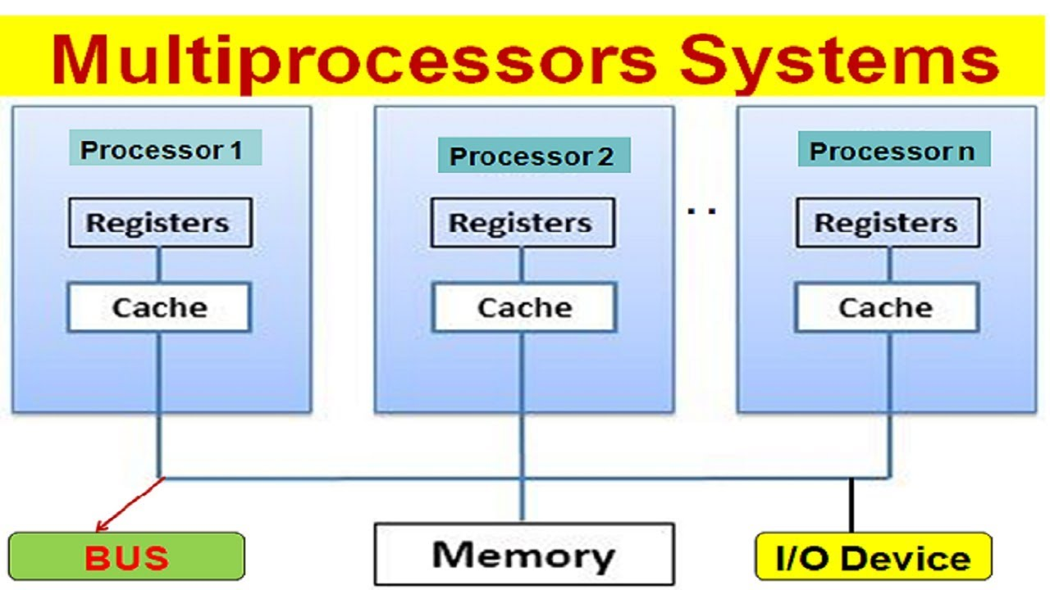
Operating System Architecture
Multiprocessor Systems (parallel systems or multicore systems ):
Such systems have two or more processors in close communication, sharing the computer bus and sometimes the clock, memory, and peripheral devices.
A dual-core system

Slide 26
Operating System Architecture
Clustered Systems:
Special kind of multiprocessor system which gathers together multiple CPUs. They are composed of two or more individual systems- or nodes - joined together.
Clustered computers share storage and are closely linked via a local-area network (LAN) or a faster interconnect, such as InfiniBand

Slide 27
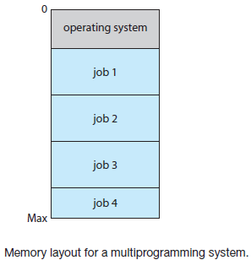
Operating System Structure
Multiprogramming:
Increases CPU utilization by organizing jobs (code and data) so that the CPU always has one to execute.
OS keeps several jobs in memory simultaneously. As main memory is small, it keeps the jobs on the disk (job pool) which waits there to be allocated in the main memory.
OS picks and begins to execute one of the jobs in memory. Eventually, the job may have to wait for some task. OS picks another job from the pool to execute while the previous one waits.

Slide 28
Requirements of Multiprogramming
Job Scheduling: If several jobs are ready to be brought into memory, and if there is not enough room for all of them, then the system must choose among them.
When OS selects a job from the job pool, it loads that job into memory for execution. Having several programs in memory at the same time requires some form of memory management.
CPU Scheduling: if several jobs are ready to run at the same time, the system must choose which job will run first.
Running multiple jobs concurrently requires that their ability to affect one another be limited in all phases of the operating system.
If processes don’t fit in memory, swapping moves them in and out to run from main memory achieving this goal is virtual memory.

Slide 29
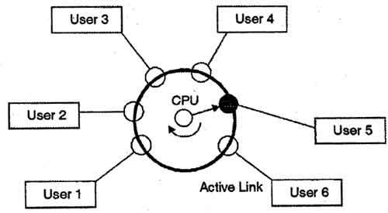
Operating System Structure
Time Sharing:
CPU executes multiple jobs by switching among them.
Switches occur so frequently that the users can interact with each program while it is running.
requires an interactive computer system, which provides direct communication between the user and the system.
Response time should be short.

Slide 30
Operating System Operations
Modern operating systems are interrupt driven
Events are almost always signaled by the occurrence of an interrupt or a trap
A trap (or an exception) is a software-generated interrupt
For each type of interrupt, separate segments of code determine what action should be taken
Errors can occur when one erroneous program modify another program, the data of another program, or even the operating system itself.
A properly designed operating system must ensure that an incorrect (or malicious) program cannot cause other programs to execute incorrectly.

Slide 31
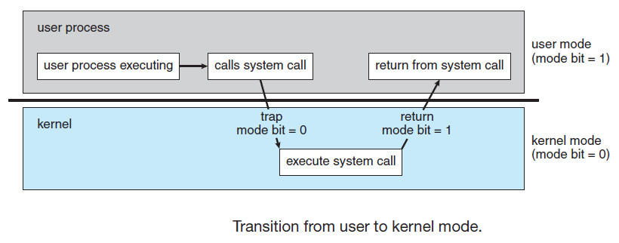
Dual Mode Operation
Need to distinguish between the execution of operating-system code and user defined code.
A bit, called the mode bit, is added to the hardware of the computer to indicate the current mode: kernel (0) or user (1).
dual mode of operation provides protection of the operating system from errant users
this protection is provided by designating some of the machine instructions that may cause harm as privileged instructions that are executed only in kernel mode.

Slide 32
Operating Systems
OS Services
FBA

Slide 33
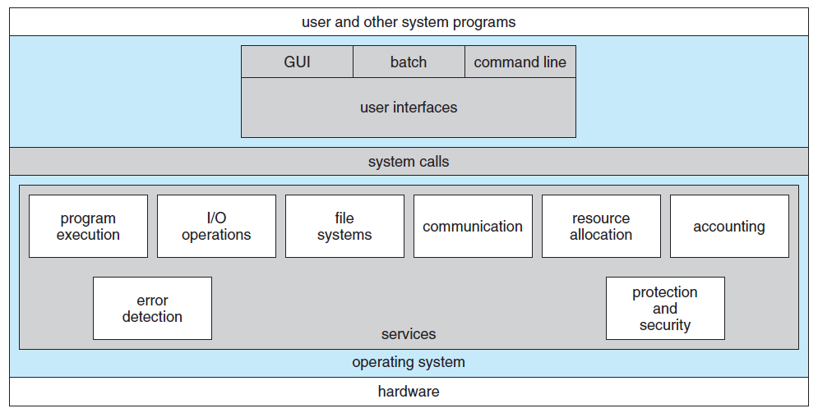
Operating System Services
OS provides an environment for the execution of programs.
Specific services provided, differ from one operating system to another, but there are some common classes
Services are provided for the convenience of the programmer

Slide 34
Operating Systems
System Call, System Program, System Boot
FBA

Slide 35
System Call
System calls provide an interface to the services made available by an operating system.
These calls are generally available as routines.
Routines are written in C or C++. Some low level tasks are written in assembly language.
A program to copy the contents of a file to another file !
Input two file name
Open the input file, and create the output file
Read from input file, and Write into output file
Close the file
Acquire input file name
Write prompt to screen
Accept input
Acquire output file name
Write prompt to screen
Accept input
Open the input file
if file doesn't exist, abort
Create output file
if file exists, abort
Loop
Read from input file
Write to output file
Until read fails
Close output file.
Write completion message to screen.
Terminate normally.
System Calls

Slide 36
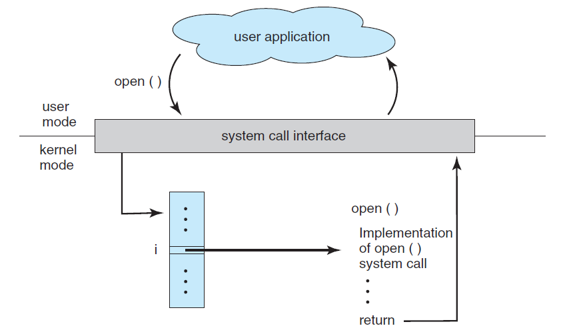
System Call Interface
Serves as the link to system calls made available by the operating system.
A number is associated with each system call, and the system-call interface maintains a table indexed according to these numbers.
Invokes the intended system call in the operating-system kernel and returns the status of the system call and any return values.

Slide 37
Types of System Call
Type | Windows OS | Linux OS
Process Control | CreateProcess() ExitProcess() WaitForSingleObject() | fork() exit() wait()
File Manipulation | CreateFile() ReadFile() WriteFile() CloseHandle() | open() read() write() close()
Device Manipulation | SetConsoleMode() ReadConsole() WriteConsole() | ioctl() read() write()

Slide 38
Types of System Call
Type | Windows OS | Linux OS
Information Maintenance | GetCurrentProcessID() SetTimer() Sleep() | getpid() alarm() sleep()
Communication | CreatePipe() CreateFileMapping() MapViewOfFile() | pipe() shm_open() mmap()
Protection | SetFileSecurity() InitlializeSecurityDescriptor() SetSecurityDescriptorGroup() | chmod() umask() chown()

Slide 39
System Programs
System programs, also known as system utilities, provide a convenient environment for program development and execution.
These system programs provide -
File management
Status information
File modification
Programming-language support
Program loading and execution
Communications
Background services

Slide 40
System Boot
When power initialized on system, execution starts at a fixed memory location.
Firmware ROM used to hold initial boot code
Operating system must be made available to hardware so hardware can start it.
Small piece of code – bootstrap loader, stored in ROM locates the kernel, loads it into memory, and starts it
Sometimes two-step process where boot block at fixed location loaded by ROM code, which loads bootstrap loader from disk
Common bootstrap loader, GRUB, allows selection of kernel from multiple disks, versions, kernel options
Kernel loads and system is then running.

Slide 41
Operating Systems
OS Structures
FBA

Slide 42
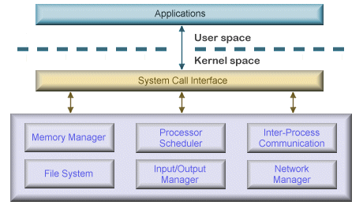
OS Structure
Simple/Monolithic structure:
Earliest and most common architecture
Every component of OS is in the kernel and can communicate with each other directly
Complex and Large ( millions line of code , ) hard to maintain

Slide 43
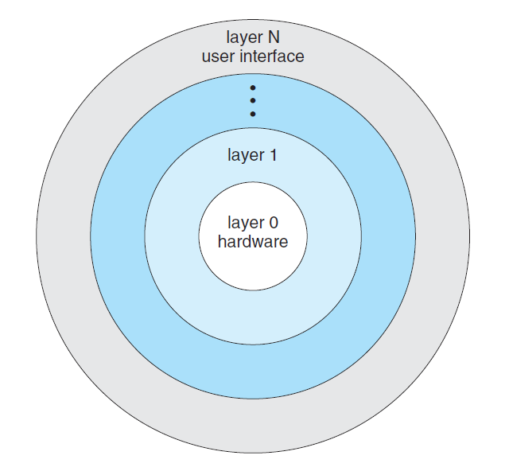
OS Structure
Layered structure:
OS is divided into layers.
Each layer can use services of its lower layers.
Easy to debug and develop.
Less efficient as each layer adds some overhead

Slide 44
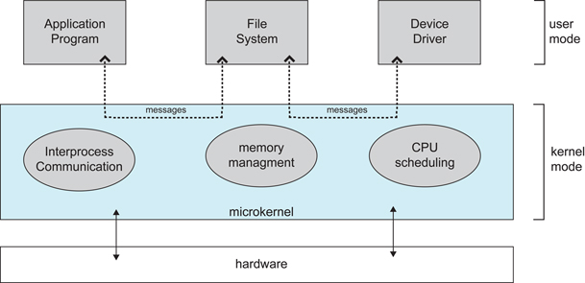
OS Structure
Microkernel structure:
Moves as much from kernel into user space
Communication takes place between user modules using message passing
Easier to extend a microkernel
More reliable( less code running in kernel mode ) and secure
Performance overhead

Slide 45


Slide 46
Upcoming Episodes
Process:
Process States: A condition of the process at a specific instant of time.
Process Architecture: The structural design of general process systems.
Operations on Process: process creation, preemption, blocking, and termination etc
Process Scheduling: A task that schedules processes of different states like ready, waiting, and running
Process Synchronization: The task of coordinating the execution of processes

Slide 47
Upcoming Episodes
Thread:
Definition & Purpose: a sequential flow of tasks within a process.
Multithreading Models: Ways of achieving multithreading
Thread Library: provides the programmer with an Application program interface for creating and managing thread
Threading Issues: Common problems and pitfalls with multi-thread programming

Slide 48

Upcoming Episodes
Deadlock:
Reason
Necessary Conditions for Deadlock
Methods of Handling Deadlocks

Slide 49
Upcoming Episodes
Memory Management:
Background and importance of memory management
Memory Management Techniques
Virtual Memory

Slide 50

THE END

